Slide 1
TechLabs Düsseldorf x Huawei Hackathon

Slide 2
XXX Nature Amigos
Chiang Yung-Hsuan
Lee Ming Cheng
Revan Dhanasekaran
Julia Alvarez
Nancy Nyambura

Slide 3
Project Idea
Let see what the current situation is….
Notes:
Dialog

Slide 4


Project Idea
Notes:
So what happend?
Lisa don‘t want to go out
she a mentioned couple of obstacles which can easily be solved
which WE solved by offering a tool
which not only sends a daily reminder to take a walk
but also offers a route nearby
andthe most important it provides informationa about the air pollution
to be more specific the (??? raven)

Slide 5

XXXProject Idea
Air Quality
Green Areas
Short daily walking routes

Slide 6
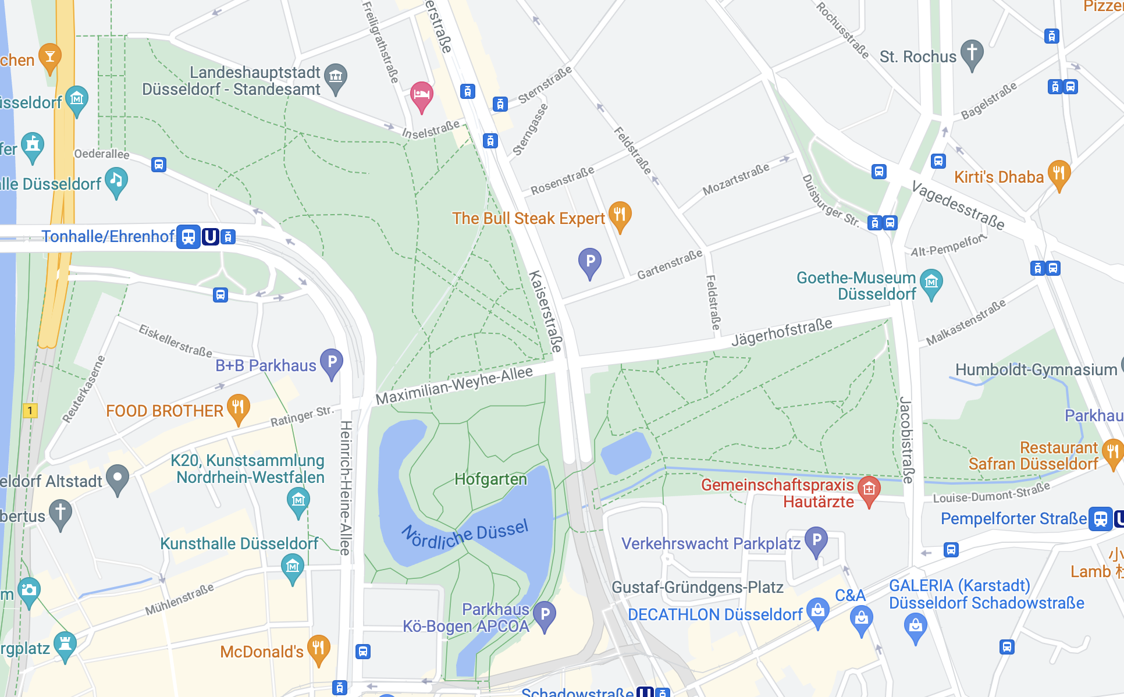

XXXXApproach
.gpx route data
latitude & longitude of jogging routes
Notes:
the unique part about our approach is that
we did not use third party data
but

Slide 7
Approach
.gpx route data
latitude & longitude of jogging routes
Notes:
the unique part about our approach is that
we did not use third party data
but

Slide 8
Challenges
No direct air quality index dataset
Only two measurement stations in operation
Not all pollutants data available

Slide 9
Challenges
dataset problems
only two stations are working
choosing the right map
don’t wanted the classical google maps
table

Slide 10
Results
Now lets see what changed!

Slide 11
Further development opportunities

Slide 12
Sources
https://www.youtube.com/watch?v=oPVcEvZvvaU&t=60s

